Slide 1


Foundations of
Scientific Computing
(SciComp 101)
Dave Biersach
dbiersach@bnl.gov
Session 10
Random Numbers and Algorithms

Slide 2
Session 10 – Goals
Appreciate how to encode and decode objects as numbers
Generate random numbers using Numpy
Access Numpy array elements using the [] operator
Measure (instrument) code performance using Python's built-in high-precision timers
Review run-time complexity and big-O notation
Represent anonymous variables with a single underscore
Incrementally improve code to find prime numbers

Slide 3
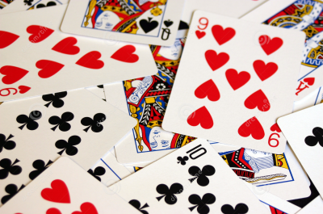
Encoding (Representation)
Cards in a deck are numbered 0 – 51
Card Suit |  |  | Card Rank
0 | Clubs |  | 0 | Deuce
1 | Diamonds |  | 1 | Three
2 | Hearts |  | 2 | Four
3 | Spades |  | 3 | Five
 |  |  | 4 | Six
 |  |  | 5 | Seven
 |  |  | 6 | Eight
 |  |  | 7 | Nine
 |  |  | 8 | Ten
 |  |  | 9 | Jack
 |  |  | 10 | Queen
 |  |  | 11 | King
 |  |  | 12 | Ace
How can we convert to & from a card# and a specific suit and rank?

Slide 4
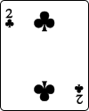

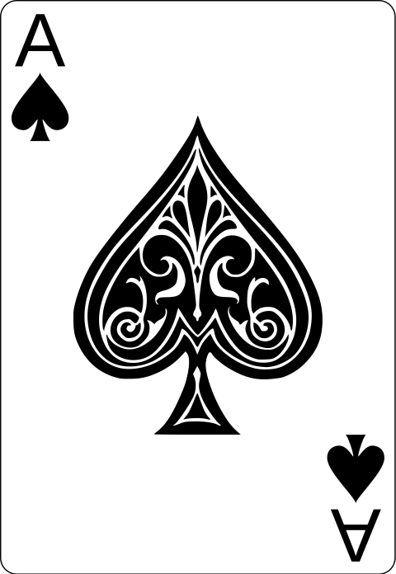
Encoding (Representation)
Cards in a deck are numbered 0 – 51
Card# = Suit * 13 + Rank
Card Suit |  |  | Card Rank
0 | Clubs |  | 0 | Deuce
1 | Diamonds |  | 1 | Three
2 | Hearts |  | 2 | Four
3 | Spades |  | 3 | Five
 |  |  | 4 | Six
 |  |  | 5 | Seven
 |  |  | 6 | Eight
 |  |  | 7 | Nine
 |  |  | 8 | Ten
 |  |  | 9 | Jack
 |  |  | 10 | Queen
 |  |  | 11 | King
 |  |  | 12 | Ace
Suit = 0
Rank = 0
0 * 13 + 0 = 0
Suit = 2
Rank = 10
2 * 13 + 10 = 36
Suit = 3
Rank = 12
3 * 13 + 12 = 51

Slide 5
Decoding (Representation)
Cards in a deck are numbered 0 – 51
Suit = Card# // 13
Rank = Card# % 13
Card Suit |  |  | Card Rank
0 | Clubs |  | 0 | Deuce
1 | Diamonds |  | 1 | Three
2 | Hearts |  | 2 | Four
3 | Spades |  | 3 | Five
 |  |  | 4 | Six
 |  |  | 5 | Seven
 |  |  | 6 | Eight
 |  |  | 7 | Nine
 |  |  | 8 | Ten
 |  |  | 9 | Jack
 |  |  | 10 | Queen
 |  |  | 11 | King
 |  |  | 12 | Ace
// returns the integer quotient
39 // 7 = 5
% is the modulus (remainder)
39 % 7 = 4

Slide 6
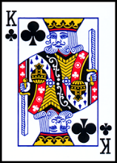
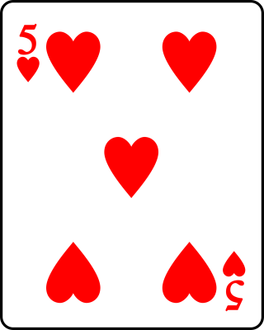
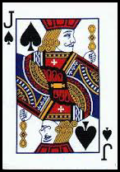
Decoding (Representation)
Cards in a deck are numbered 0 – 51
Suit = Card# // 13
Rank = Card# % 13
Card Suit |  |  | Card Rank
0 | Clubs |  | 0 | Deuce
1 | Diamonds |  | 1 | Three
2 | Hearts |  | 2 | Four
3 | Spades |  | 3 | Five
 |  |  | 4 | Six
 |  |  | 5 | Seven
 |  |  | 6 | Eight
 |  |  | 7 | Nine
 |  |  | 8 | Ten
 |  |  | 9 | Jack
 |  |  | 10 | Queen
 |  |  | 11 | King
 |  |  | 12 | Ace
Card # = 11
Suit = 11 // 13 = 0
Rank = 11 % 13 = 11
Card # = 29
Suit = 29 // 13 = 2
Rank = 29 % 13 = 3
Card # = 48
Suit = 48 // 13 = 3
Rank = 48 % 13 = 9

Slide 7
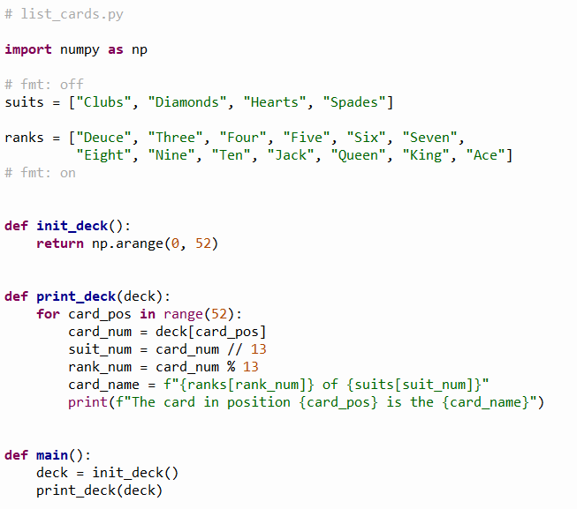
Open list_cards.py
Note: You should not edit this file!
①
②
④
⑤
⑦
⑧
⑨
⑩
③
⑥

Slide 8
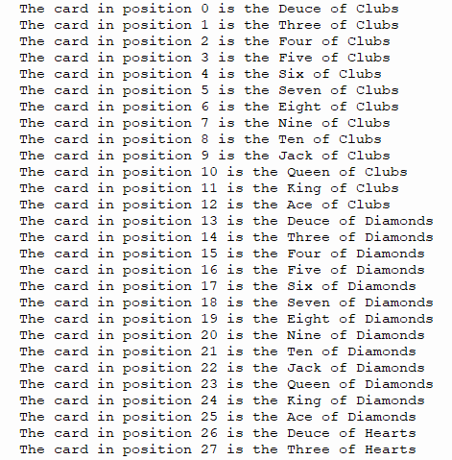
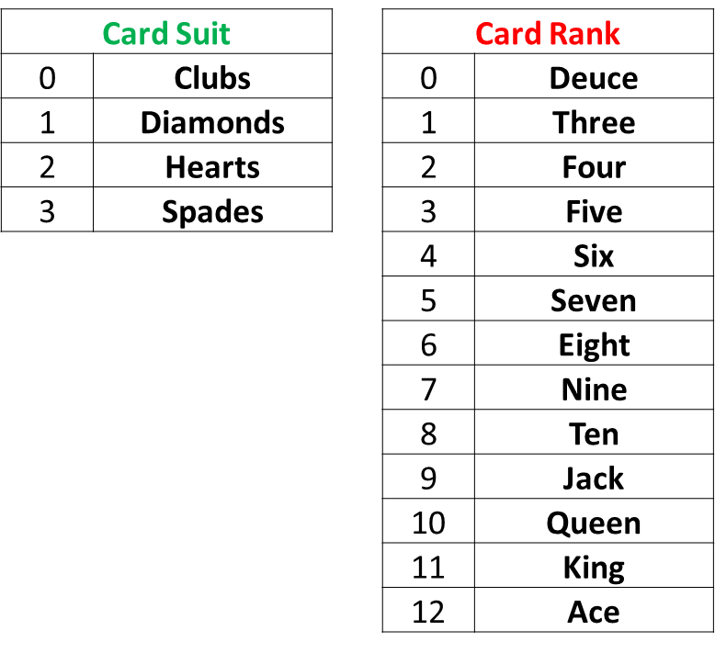
Run list_cards.py

Slide 9
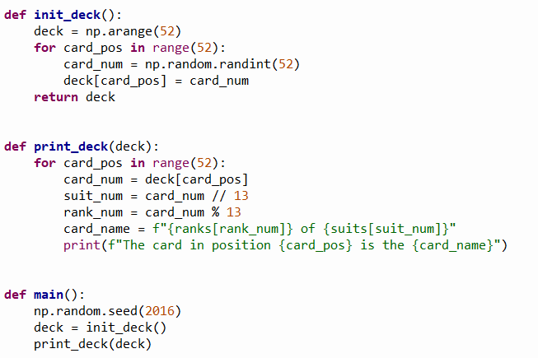
Open dealer_bogus.py
Note: You should not edit this file!
Let’s randomize the initial deck
③
④
⑤
⑥
⑦
⑧
⑩
①
②
⑨

Slide 10
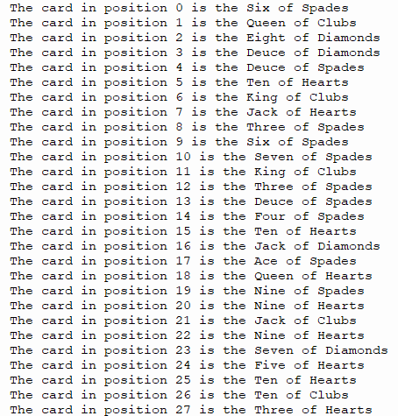

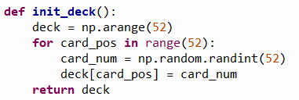
Run dealer_bogus.py
☹

Slide 11
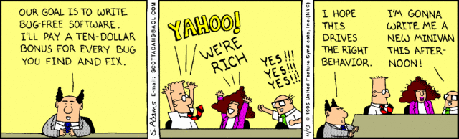
Random… but no repeats?
How can we get a set of random numbers where no number is repeated until all numbers are picked at least once?
Can we flag that a particular card # has already been dealt, and therefore not deal that card again?

Slide 12
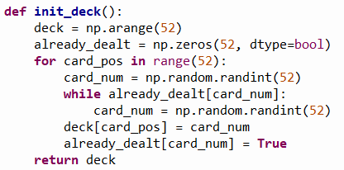
Open dealer_slow.py
Note: You should not edit this file!
We need a helper array to store a True or False flag to record if a random trial card number has already been dealt.
Then we need to keep picking random trial card numbers until a card number is found that has yet to be dealt. When that card is found, we update the helper array to record that card number has been dealt so it cannot be picked again.
①
②
③
④
⑤
⑥
⑦
⑧
⑨
⑩

Slide 13
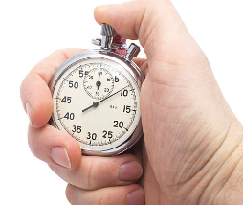
Instrumenting Your Code
Instrumenting code is the process of taking accurate timings of the runtime performance of key algorithms within the program
Python provides a time object that can measure the current CPU time of a running process to the nearest millisecond (1/1000th of a second) which is sufficient in most situations
We bracket the code under analysis by measuring the clock immediately before the start and again after the end of the algorithm to calculate the elapsed time
Careful tracking of code timings will provide objective empirical evidence if changes to algorithms and/or data structures are indeed making the program more efficient

Slide 14
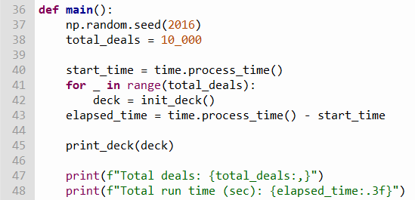
View dealer_slow.py
Write code to time how long it takes to correctly initialize 10,000 decks
①
②
③
④
⑤
⑥
⑦

Slide 15
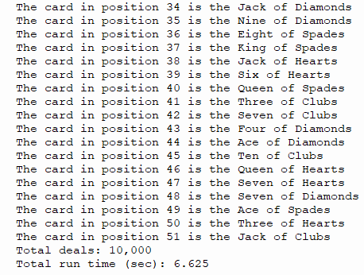
Run dealer_slow.py
No repeated cards!
☺

Slide 16
Correct but inefficient…
dealer_bogus.py
dealer_slow.py

Slide 17
A Faster Card Dealer
There is an inherent inefficiency in the naïve algorithm employed in the current init_deck() function
It takes longer and longer, as more cards are dealt, to randomly pick (find) a card that has not yet been dealt
We need to discover an algorithm that, while ensuring every card is dealt only once, doesn't lose time at the end of the deal searching for that one remaining card that has not yet been dealt
The improved algorithm doesn’t need an already_dealt helper array, and a 7th grader discovered it!

Slide 18
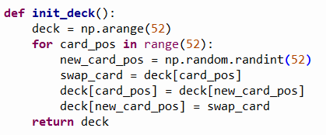
Open dealer_fast.py
Note: You should not edit this file!
Consider the revised init_deck() function:
What is going on in this function that ensures no duplicate cards are dealt and doesn't waste time trying to find the cards at the end that have not yet been dealt?

Slide 19
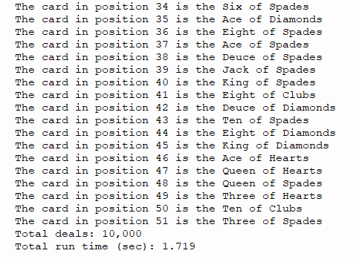
Run dealer_fast.py
No repeated cards!
☺

Slide 20
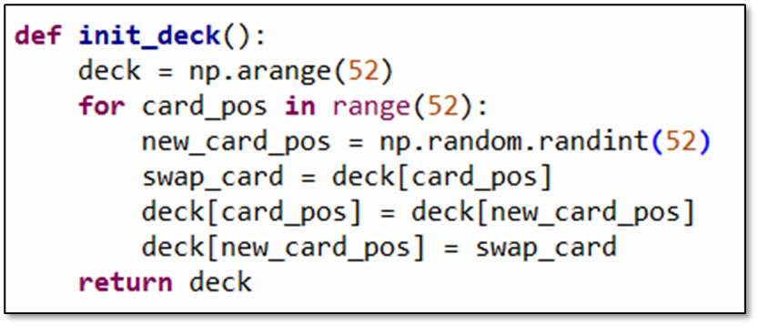
Slow vs. Fast Card Dealer
dealer_slow.py
dealer_fast.py
Fewer lines of code
No helper list needed
~4X faster
Discovered by a 7th grader

Slide 21
Computing is a New Science
The best algorithms are the ones that leave you scratching your head thinking “…that was so obvious – why didn’t I think of that?”
They are often the shortest algorithms in terms of source code length (but not always)
They are also normally the fastest algorithms to execute
For many algorithms, we have yet to discover the provably optimal approach – there is still so much unknown
Even students taking an initial computer science course can get a flash of inspiration and see something in a new way!

Slide 22
Algorithmic Efficiency
Scientific computing often involves analyzing large data sets or running large-scale simulations
It is essential to have code that runs as fast as possible while returning the correct results
We measure algorithm efficiency by estimating the impact on the total run time as the size of the input data increases
We are only interested in the principal (highest exponent) term, which describes the overall “order” of the algorithm, as we are not trying to calculate the exact run time
The order of an algorithm is expressed in “Big O” notation
The optimal algorithms have the smallest possible order

Slide 23
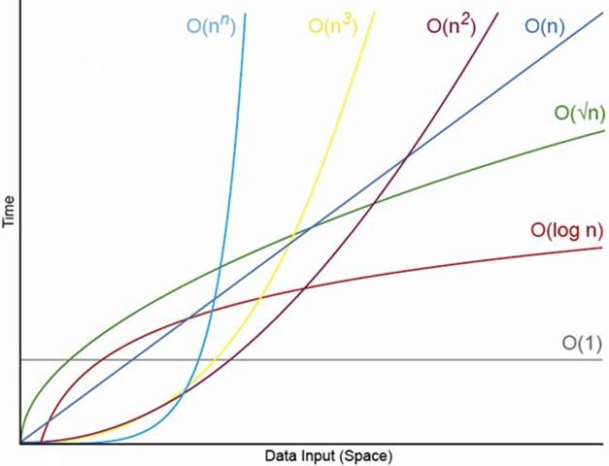
Algorithmic Efficiency
n is the # of items you must process
increasing n # of items

Slide 24
Prime Racer
Write a program to generate a list of 100,000 random integers in the range [1,000, 10,000)
Count the number of prime numbers within that list
Use the time.process_time() function to instrument your code and measure the total run time in seconds
As we make changes to the algorithm, we will compare the run time between each version to prove that our improvements have indeed improved the code efficiency
However, as we further optimize the program, we must continue to ensure it is still emitting the correct and consistent output

Slide 25
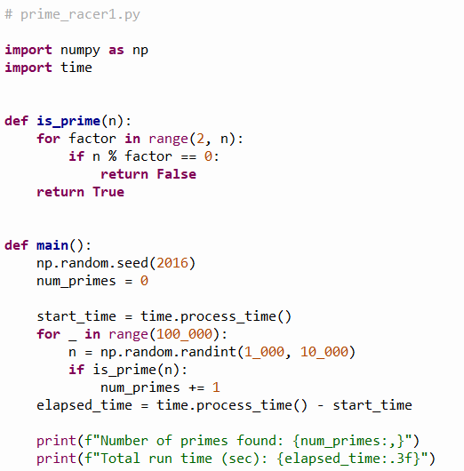
Open prime_racer1.py
Note: You should not edit this file!
①
②
③
④
⑤
⑥
⑦
⑧
⑨
⑩

Slide 26
View prime_racer1.py
Note: You should not edit this file!
①
②
③
④
⑤

Slide 27
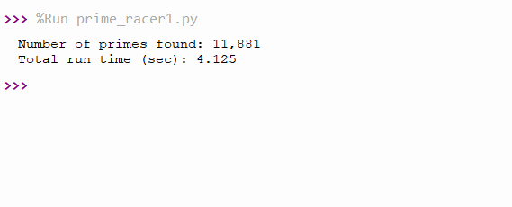
Run prime_racer1.py
①
②
What improvements could we make to reduce the work the algorithm must perform to count the number of primes?

Slide 28
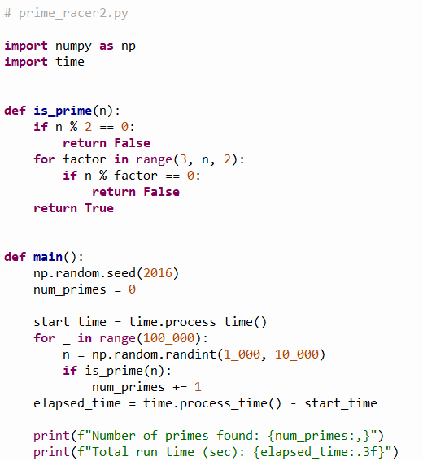
Open prime_racer2.py
Note: You should not edit this file!
①
②
③
④

Slide 29

Run prime_racer2.py
①
②
Do we need to test all the odd numbers less than n?

Slide 30
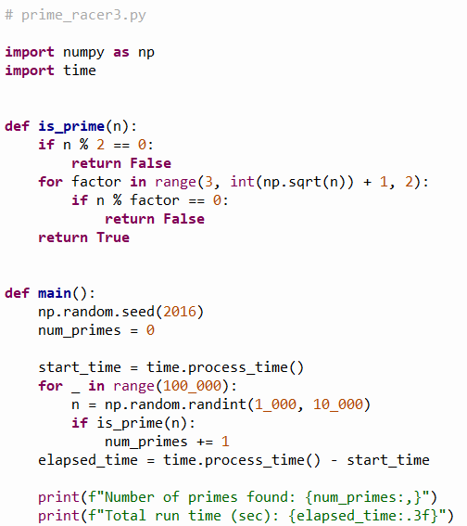
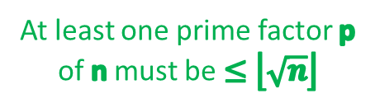
Open prime_racer3.py
Note: You should not edit this file!
At least one prime factor p of n must be $≤\left\lfloor \sqrt{n}\right\rfloor$
①

Slide 31

Run prime_racer3.py
①
②

Slide 32
Measurable Systematic Improvement
We reduced the run time by 90% by just thinking carefully about the nature of the problem

Slide 33
Session 10 – Know You Know…
The art of computer science is finding an efficient way to represent everything as a number
An encoding must be unambiguous to support proper decoding
Decoding multiple things from a single number often requires the use of the modulus % operator
We can instrument (time) code by measuring the elapsed time between when it starts and ends
Algorithm design remains an area of very active research and even new programmers can make a novel contribution

Slide 34
Task 10
Update the Python program called lcm_from_gcd.py to calculate the lowest common multiple (LCM) of two integers
You may only use basic arithmetic operators - no looping constructs
Hint: you may use NumPy's gcd() function
Calculate and display the LCM of 447618 and 2011835

